Slide 1
ATLIQ HARDWARE
Sales Insights from ad-hoc requests
Prepared by Gunjan Trehan
March 2023

Slide 2
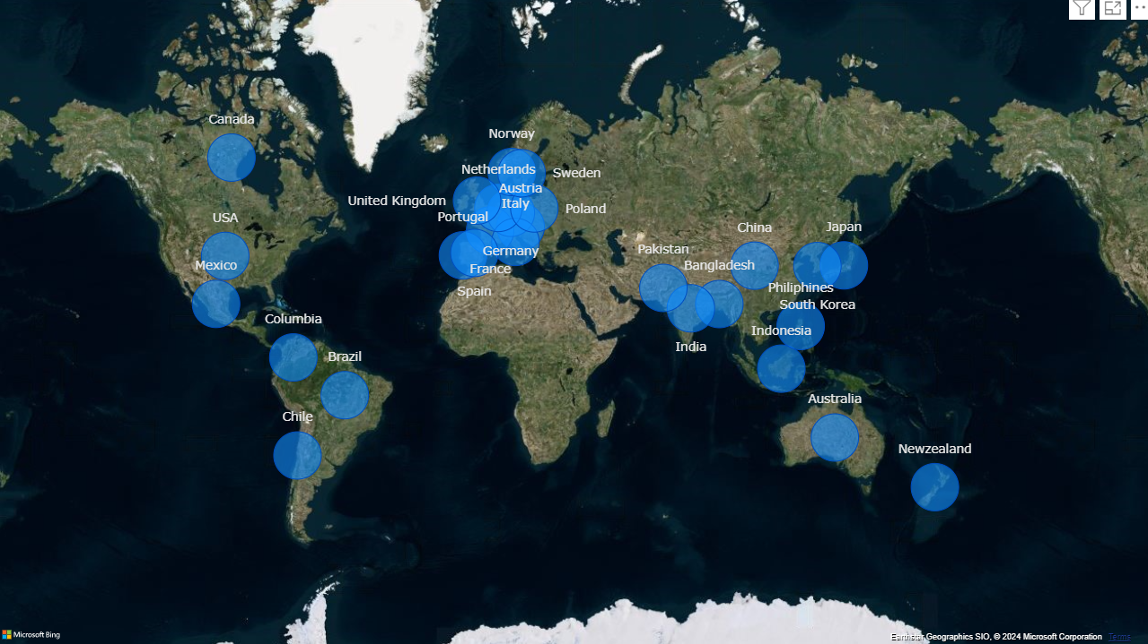
COMPANY’S MARKET
Atliq Hardware actively doing business in 27 countries across NA, EU and APAC region

Slide 3
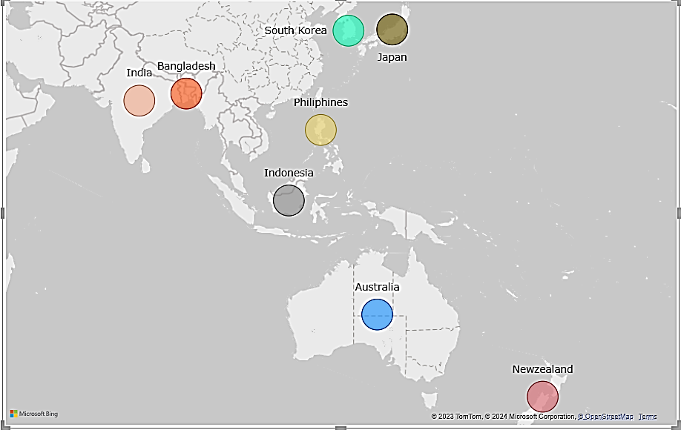
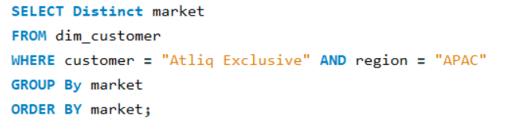
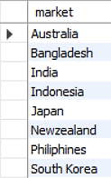
QUERY & INSIGHTS
Q1. Provide the list of markets in which customer 'Atliq Exclusive' operates its business in the APAC region
Query
Output
Atliq Exclusive operates its business in 8 major markets of Asia Pacific region
Atliq Exclusive has the most stores in APAC region followed by EU(6) and NA(2)

Slide 4
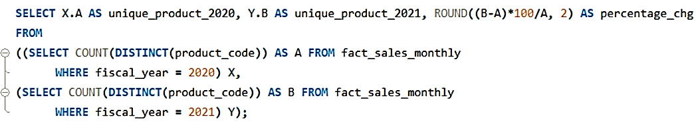


QUERY & INSIGHTS
Q2. What is the percentage change of unique product increase in 2021 Vs. 2020? The final output contains the fields, unique_products_2021, unique_products_2020, Percentage_chg
Query
36.33%
Output
Atliq observed an increase of 36.33% in number of unique products from 2020 to 2021

Slide 5
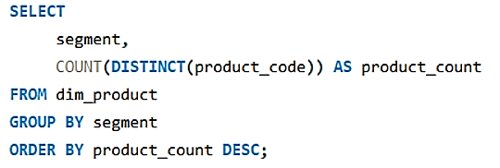
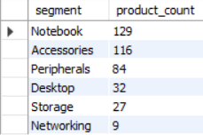
QUERY & INSIGHTS
Q3. Provide a report with all the unique product counts for each Segment and Sort them in descending order of product counts. The final output contains 2 fields: Segment, product_count
Query
Output
Atliq observed an increase of 36.33% in number of unique products from 2020 to 2021

Slide 6
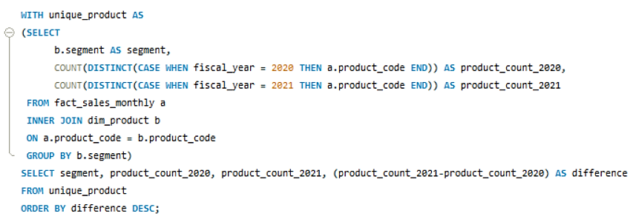
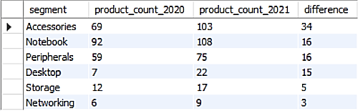
QUERY & INSIGHTS
Q4. Follow-up: Which segment had the most increase in unique products in2021 vs 2020? The final output contains these fields,segmentproduct_count_2020product_count_2021difference
Query
Output
Accessories had the largest production growth over period
Storage and Networking production is at lower rate in comparison to other segments

Slide 7
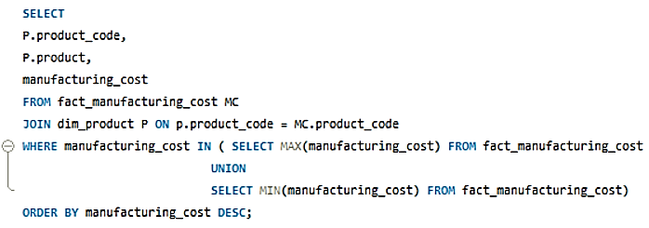



QUERY & INSIGHTS
Q5. Get the products that have the highest and lowest manufacturing costs. The final output should contain these fields, product_code, product, manufacturing_cost
Query
Output
Mouse: AQ Master wired x1 Ms has lowest manufacturing cost
Personal Desktop: AQ Home Allin1 Gen2 has highest manufacturing cost

Slide 8
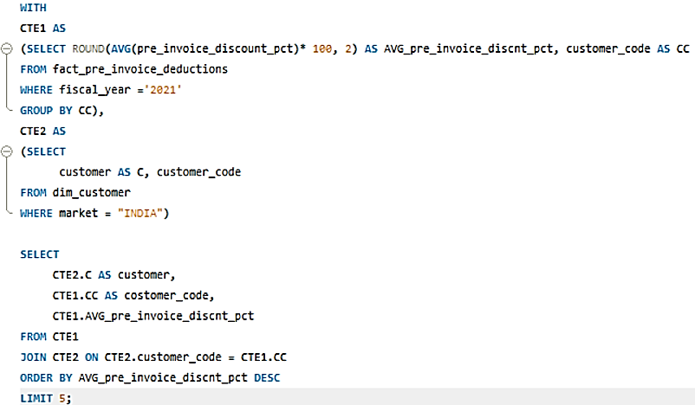
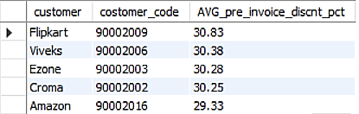
QUERY & INSIGHTS
Q6. Generate a report which contains the top 5 customers who received an average high pre_invoice_discount_pct for the fiscal year 2021 and in the Indian market. The final output contains these fields, customer_code, customer, average_discount_percentage
Query
Output

Slide 9
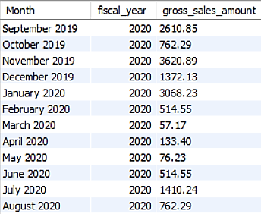
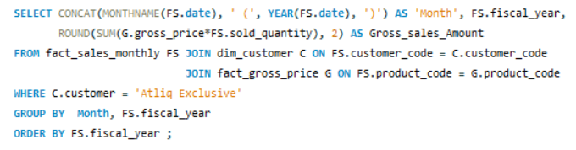
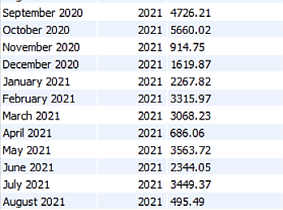
QUERY & INSIGHTS
Q7. Get the complete report of the Gross sales amount for the customer “AtliqExclusive” for each month. This analysis helps to get an idea of low and high-performing months and take strategic decisions. The final report contains these columns: Month, Year, Gross sales Amount
Query
Output

Slide 10
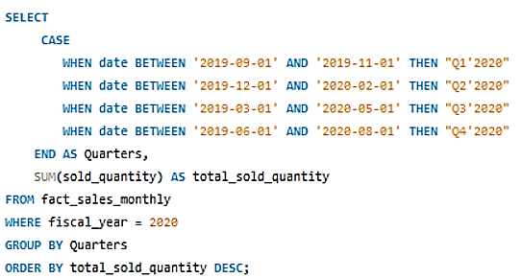
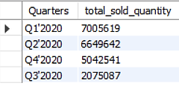
QUERY & INSIGHTS
Q8. In which quarter of 2020, got the maximum total_sold_quantity? The final output contains these fields sorted by the total_sold_quantity, Quarter, total_sold_quantity
Query
Output

Slide 11
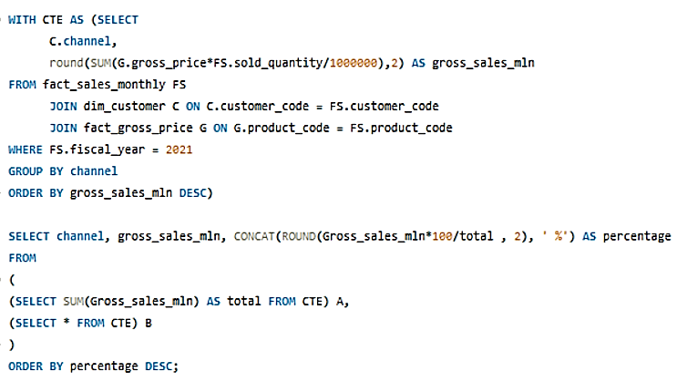

QUERY & INSIGHTS
Q9. Which channel helped to bring more gross sales in the fiscal year 2021and the percentage of contribution? The final output contains these fields: channel, gross_sales_mln, percentage
Query
Output

Slide 12
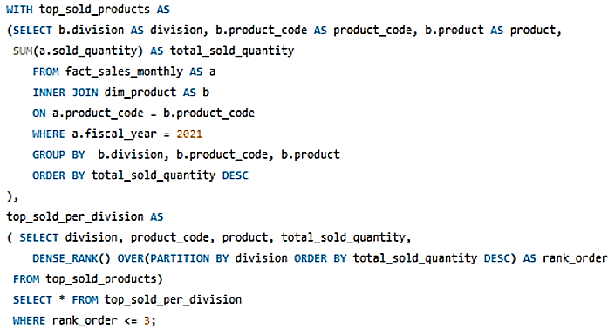
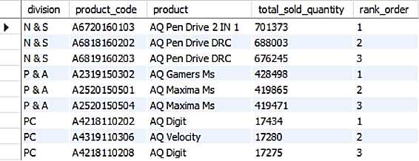
QUERY & INSIGHTS
Q10. Get the Top 3 products in each division that have a high total_sold_quantity in the fiscal_year 2021? The final output contains these fields: division, product_code, product, total_sold_quantity, rank_order
Query
Output

